Slide 1
Chapter 2
Accessing Networks “Randomly”

Slide 2
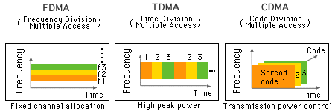
Accessing “Air”
By mid-1990, 2nd generation cellular has gained momentum with both TDMA and CDMA
Can we access air via a fundamentally different way?
Medium Access Control (MAC) schemes/protocols

Slide 3
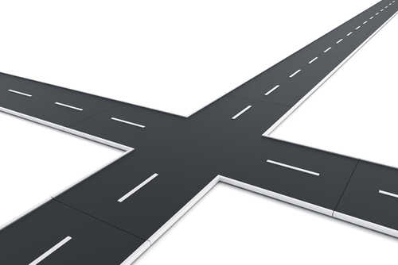
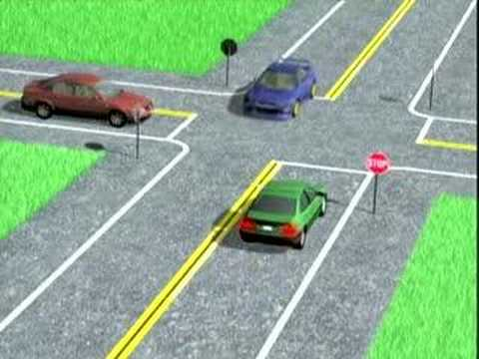
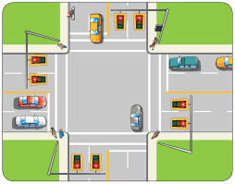
“Transportation” Analogy
How to regulate traffic at intersection?
Stop Sign
Traffic Lights

Slide 4
Traffic Light vs. Stop Sign
Traffic light
  With green light, intersection is dedicated to you
  Similar to how time/frequency/code is allocated for duration of a call in cellular networks
  What’s bad about this solution?
    stuck at red light and nobody is driving by other way
    how to resolve this frustration?
Stop sign
  More “efficient” way to regulate traffic
  Need coordination “rule” to minimize chance of accidents
    stop and look

Slide 5
Random Access
No dedicated resource - intersection is shared as long as cars follow rules of random access
What rule?
  listen before transmitting (listen before talk - LBT)
Pros and Cons
  P: more efficient when traffic volume is small and varying
  C: neither scalable nor deterministic as number of cars (or volume of traffic) increases
    “stop and go” one-by-one causes long delay

Slide 6
Birth of WiFi
In 1985, FCC officially released some spectrum to public that did not require a license
  unlicensed bands
These bands, centered around 2.4 and 5.8 GHz, are called Industrial, Scientific, and Medical (ISM) bands
Cellular operators pay for expensive licenses for bands used in cellular networks
Other devices may also operate in unlicensed bands
  microwave oven – these frequencies happen to excite water molecules well
Officially, WiFi (Wireless Fidelity) is called IEEE 802.11 – 802 for local area network; 11 for wireless

Slide 7
WiFi Standards
(1.3 Gbps)
ax 2019 2.4 & 5 4x
Maximum rated speeds are only attainable in theory
Under realistic conditions, you would be lucky to get more than a fraction of advertised ideal speed

Slide 8
Popularity of WiFi
With improving transmission speeds, demand for WiFi services continues to increase
By 2011, more than a billion WiFi devices around the world, with hundreds of millions being added each year
Passed 10 billion unit mark in January 2015
Surpassed 15 billion by end of 2016

Slide 9
How WiFi Is Deployed
WiFi’s method of “sharing the air” is very different from cellular’s
But the way WiFi is deployed is actually quite similar to cellular
Wired access backhaul (e.g., Ethernet) to Internet
Users in WiFi networks lie in Basic Service Set (BSS), rather than a cell
Within each BSS, users communicate directly with an Access Point (AP), rather than a base station (BS)

Slide 10
WiFi Channels
Each AP operates on a given frequency channel
Overall ISM band is divided into a number of such channels, each with pre-determined width
For 802.11b (in US), 11 channels around 2.4 GHz
Channels 1, 6, and 11 are non-overlapping
All devices in the same BSS use the same channel
Many WiFi deployments just use default settings of their APs, so many are on the same channel unnecessarily, hurting performance
center frequency
tools

Slide 11
WiFi Setup at Home
Wireless router serves as AP in home’s BSS
Wireless router = AP + router
Coax Cable: Comcast/Xfinity (xFi)
Fiber: Verizon FiOS
or Fiber

Slide 12
How to “Connect” to WiFi
When your device searches for WiFi connectivity, it sends messages to discover which APs are in its transmission range
This results in a list of network names that you can choose from on your screen
Each of these user-friendly names identifies a service set, and they are more commonly known as Service Set Identifiers (SSIDs)
If AP is password protected (with a 🔒), your device can associate with (i.e., connect to) it only if you have password to authenticate your status

Slide 13
AP Selection
Device scans air and determines AP that offers highest SIR, the one it associates with

Slide 14
Methods of Random Access
When two transmitters that are within interference range of each other send at similar times, their transmitted frames will collide
3 possible outcomes of a collision
  the worst case where both frames are lost
  capture: meaning that the stronger (in terms of SIR) of the two frames is received.
  double capture: the best case that both frames are properly received
Which outcome prevails depends very strongly on a few factors
We assume the worst case in the following discussion

Slide 15
Methods of Random Access
Cellular manages interference via power control
WiFi has properties which prevent power control from being an effective solution
  WiFi frequency bands (spectrum) are unlicensed and free: there’s a lot more (people/devices) interference that we have no control over
  WiFi has a much smaller cell size: adding another person to a BSS can make a big difference in interference conditions, because there are only a few to start with
  WiFi has a much smaller maximum transmit power: since ISM band is unlicensed, we cannot crank power up too high
If we can’t use power control, then how does WiFi deal with interference?

Slide 16
“Managing” Interference
WiFi tries to avoid collisions from happening in the first place
Coordination is key
TDMA - each device has its own timeslot for transmitting

Slide 17
“Managing” Interference
With WiFi, time is also the dimension of interest
Instead of dedicating timeslots, WiFi allows devices to transmit when they need to, as long as channel appears idle to them
WiFi requires devices to remain cognizant of what others are doing in an effort to prevent collisions
  this is like a driver coming to a stop sign: she has to look both ways to make sure no one is coming before proceeding
→ medium access control (MAC)
dedicated access (FDMA/TDMA in cellular)
random access (WiFi)

Slide 18
(Slotted) ALOHA
D and E are APs
Transmitters A, B, and C in interfering range of each other
At beginning of timeslot, each asks: should I send a frame, or not?
  potential results
Decision based on transmission probability
  50% - half of the time
  10% - 1 in 10 times

Slide 19
ALOHA
What happens when we decrease/increase the chance (probability) of transmission in ALOHA
  too low, more wasted (idle) slots
  too high, more collisions
Which chance (tx probability) will maximize throughput (rate of successful transmission)?

Slide 20
Throughput of (Slotted) ALOHA
3 possible outcomes at each slot
  successful transmission
  collision
  no transmission
Throughput is determined by successful transmission
What constitute a successful transmission?
  someone transmits
  rest of the stations do not transmit
For N stations, probability of tx = p
  per-station throughput = probability of one station has successful tx = p(1-p)^{N-1}
  total throughput = Np(1-p)^{N-1}

Slide 21
Throughput of (Slotted) ALOHA
  Total throughput = E(p) = Np(1-p)^{N-1}
  Find p* that maximizes E(p) → p* = 1/N
Maximum throughput when N →∞ = 1/e = 0.37

Slide 22
How Could ALOHA Be Improved?
Fundamental feature of ALOHA?
  transmit at will (or with certain probability); make no attempt to “coordinate” transmissions with other stations
  not paying attention to other (on-going) transmissions
  “coin toss” leads to wasted slot when telling not to send
  what happens when someone else is transmitting?
Fundamental problem of ALOHA: purely random, and does no sensing

Slide 23
Carrier Sensing
ALOHA is purely random and makes no attempt to “coordinate” transmissions of stations
  does no sensing
  may not send in an free slot → wasted opportunity
Stop sign analogy
  blindfolding your eyes, and randomly choosing when to go without looking to see if any cars were coming
Carrier sensing: before transmitting any frame, regularly listen to the air
A and C can hear the channel is currently occupied, and will refrain from sending anything until B is finished

Slide 24
CSMA
Once a station gets a glimpse of a quiet channel, is it allowed to begin sending immediately?
No – observe a wait-and-listen period
If a station senses channel is busy at any time during wait-and-listen period, it will stay silent
Once a station makes it to the end of wait-and-listen period without hearing anything else, it can assume channel is idle and start sending

Slide 25
CSMA
How do you know whether data is properly received?
Via feedback – ACK
There is also a wait-and-listen period before ACK

Slide 26
Patience is a Virtue
What happen when collision occurs?
Back off to later time
  determined by contention window
  random value within contention window
    how many time slots to wait before retx

Slide 27
Binary Exponential Backoff
Contention window size doubles for each collision

Slide 28
What “Speed” Can You Get?
Speed = transmission rate (bandwidth)
Different versions of WiFi have different maximum transmission rate
Channel condition fluctuates (due to, e.g., interference, etc.)
AP will tell devices to back off to lower rate if too much interference to handle current rate
(1.3 Gbps)
ax 2019 2.4 & 5 4x

Slide 29
Sensing vs. Interference Ranges
Sensing range ≠ interference range
  transmissions from A and C collide at B, but they cannot sense each other
Hidden node problem
RTS (Request to Send)
CTS (Clear to Send)
sensing/transmission range

Slide 30
WiFi DCF
Distributed Coordination Function (DCF)
Wait-to-listen: DIFS > SIFS
Why?
  give priority to transmissions that observe shorter wait-and-listen interval
  ensure “atomicity”
RTS/CTS + [DIFS > SIFS] + binary exponential backoff + randomized transmit timing
CSMA/CA (Collision Avoidance)

Slide 31
Which One to Use?
Cellular has much large and pervasive coverage
Free WiFi hotspot
  Bad when too many people around
802.11n: 70 m indoor
(Automatic) offloading
automatic switch over from cellular to WiFi when coming indoor
reduce stress on cellular infrastructure

Slide 32
CSMA vs. ALOHA
Although per-station throughput still decreases as we add more stations, CSMA does so less rapidly than it does with ALOHA
Total throughput of CSMA will actually increase as we add the first few stations, whereas it is always decreasing for ALOHA
Neither CSMA nor ALOHA is scalable to a large number of WiFi devices
  reason for poor performance at hotspots when there are a lot of people around

